Slide 1

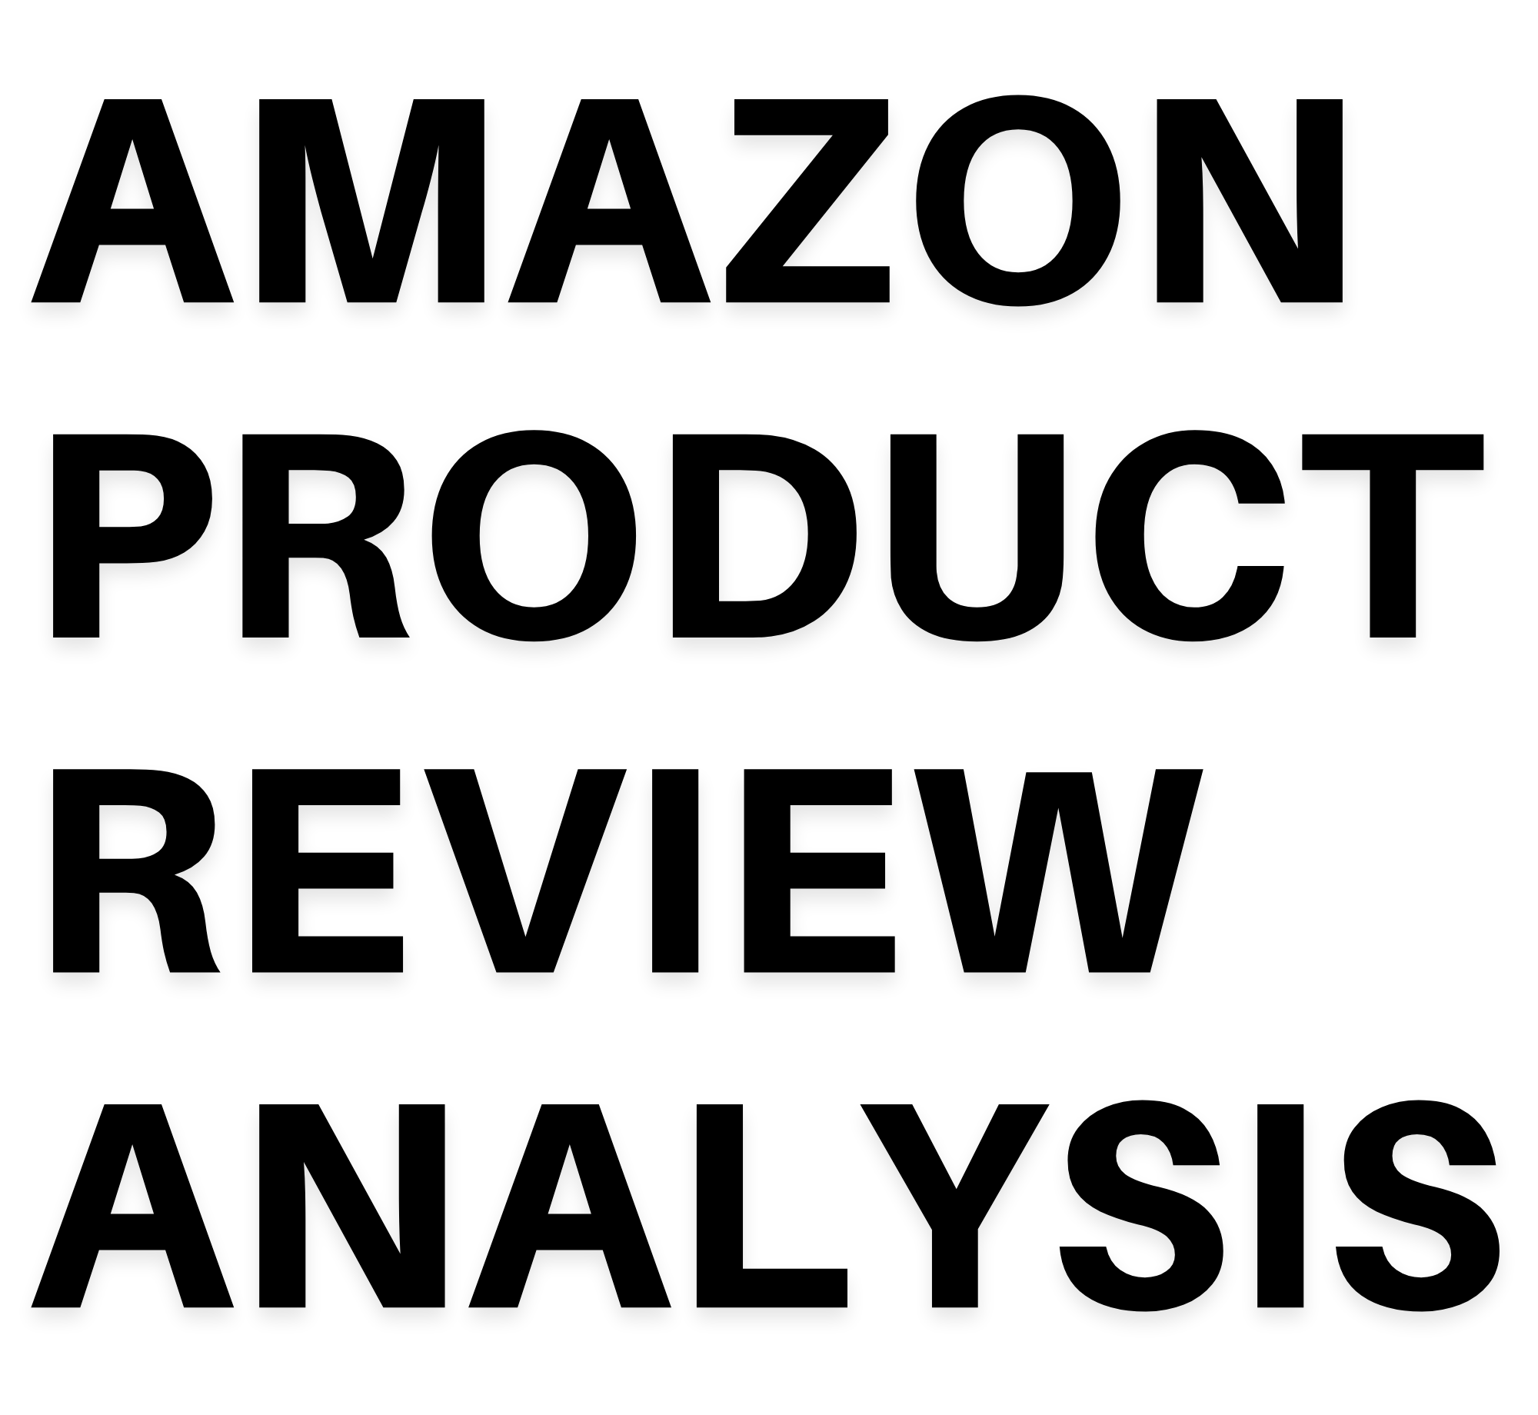


LUXURY BEAUTY DATASET
PRESENTED BY :
UDIT SINGH CHANDEL SHIKHAR NIGAM VIPUL SHARMA BHARATH KUMAR R
1

Slide 2

I
E
EXPLORATORY DATA ANALYSIS
INTRODUCTION
O
S
SENTIMENT ANALYSIS
OBJECTIVES
D
DESCRIPTIVE ANALYSIS
P
PRODUCT SEGMENTATION
D
DATA DICTIONARY
C
CUSTOMER SEGMENTATION
T
TIME SERIES SENTIMENT FORECASTING
P
PLUG AND PLAY DATASET
2

Slide 3

INTRODUCTION
AMAZON
Amazon is an American multinational technology company focusing on e-commerce, cloud computing, online advertising, digital streaming, and artificial intelligence.
Amazon's global headquarters are in more than 40 owned and leased buildings spread across Seattle's adjacent South Lake Unions.
Jeff Bezos, the CFO of amazon has different roles in the stock market worldwide and has been an inspiration to many.
Initially, it was an online marketplace for books, later the amazon buyer Sales approach warmed up so well, the company surpassed all it's competitors in a very short time.
3

Slide 4
1
TO IMPORT KEY INSIGHTS FROM THE AVAILABLE DATASETS TO MAKE INFORMED BUSINESS DECISIONS.
OBJECTIVES
2
TO CLASSIFY THE PRODUCT REVIEW BASED ON SENTIMENTS.
TO CLUSTER THE PRODUCTS FOR RECOMMENDING THE BEST PRODUCTS TO OUR CUSTOMERS AND IMPROVING THE BAD PRODUCTS FOR TIME AHEAD.
3
TO DEFINE CUSTOMER SEGMENTATION TO ADOPT MEASURES FOR DISSATISFIED CUSTOMERS LIKE PROMOTION CAMPAIGNS, AND DISCOUNTS SO THAT THEY DO NOT CHURN OUT AND GIVE LOYALTY BENEFITS TO THE SATISFIED CUSTOMERS.
4
5
TO RECOMMEND LIKABLE PRODUCTS TO THE CUSTOMERS.
6
TIME SERIES ANALYSIS OF CUSTOMER SENTIMENTS TO PREDICT FUTURE TRENDS WITH RESPECT TO PRODUCT SALES.
4

Slide 5
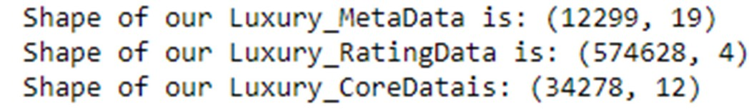
DESCRIPTIVE ANALYSIS
Datasets used
5 Core of Luxury Beauty
This particular dataset carries information mainly about Product reviews and ratings.
Metadata of Luxury Beauty
To support our Analysis and further, columns from Metadata are essential aspects when it comes to analysis of different forms.
Ratings of Luxury Beauty
The dataset beholds information about customer ratings and customer reviewer ID which can support our statements on Customer Sentiments.
5

Slide 6
_{DATA DICTIONAR}D_{Y}ATA DICTIONARY
RATING | Contains custoer ratings for a particular product
VERIFIED | Depicts if the Reviewer is verified customer or not
REVIEW TIME | It contains the information of dateon which Review is published
PRODUCT ID | Is also known as ASIN which stands for Unique amazon standard ID number
REVIEWER NAME | Depicts the name of the Reviewer It contains Reviews posted by the Customers
REVIEW TEXT
SUMMARY | Summarized version of Review Text
RANK NO | It contains the information of how the products are ranked
MAIN CATEGORY | It contains the information of Main category
PRICE | It contains the price information of the products
6

Slide 7
DATA WRANGLING
Gathering data of the amazon products along with their brand information, customer information, category information etc. from the provided data files.
DATA COLLECTION
Removal of those fields which have plenty of missing values. Removal of those fields which were insignificant to our analysis
Save our final data frame as csv file for future use
DATA EXPLORATION
DATA RESTRUCTURING
DATA
WRANGLING
Missin value imputation based on meaningful categorization.
Merging our tables on basis of matching fields.
DATA ENRICHING
DATA CLEANING
Removal of noise in our data.
Removal of those records which had plenty of missing values for essential fields.
7

Slide 8
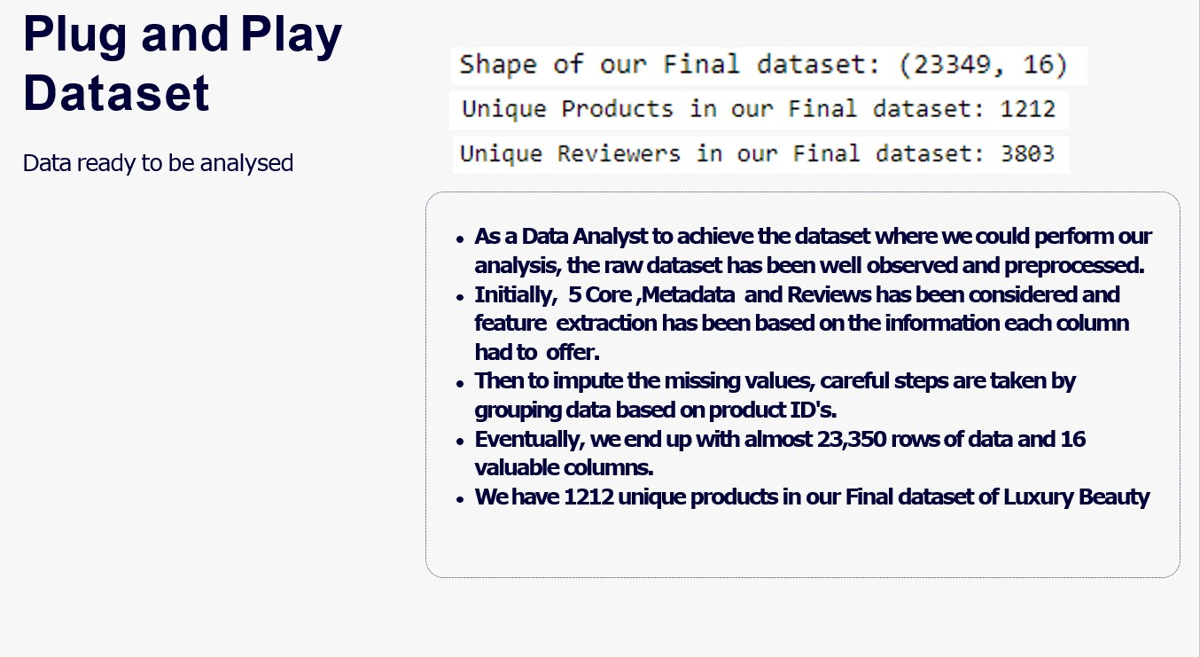
Whiteboard Page
As a data analyst to achieve the dataset where we could perform our analysis, the raw dataset has been well observed and preprocessed.
Initially, 5 CORE, Metadata, and Reviews have been considered and feature extraction has been based on the information each column had to offer.
Then to impute the missing values, careful steps are taken by grouping data based on product ids.
Eventually, we end up with almost 23,350 rows of data and 16 valuable columns. We have 1212 unique products in our final dataset of Luxury beauty.
8

Slide 9
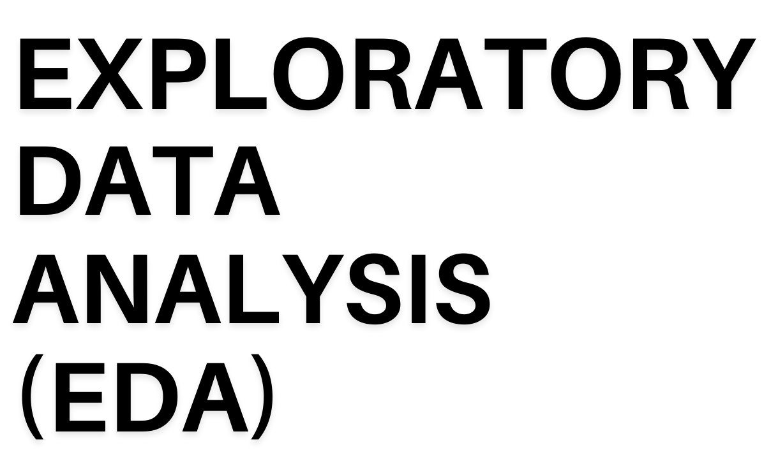
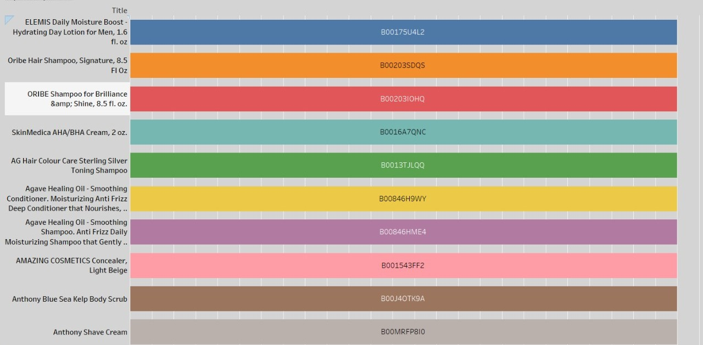
From this particular graph, we can see the top 10 rated products, evidently amazon can support these products and their respective sellers and recommend them to new customers who purchase in that particular category
BEST RATED PRODUCTS
Conclusion 20%
Problem 20%
Research 20%
Read 20%
Hypothesize 20%
9

Slide 10
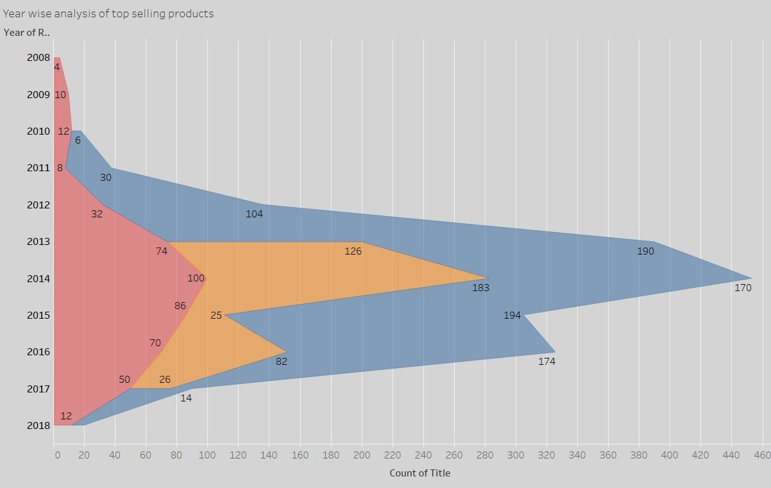
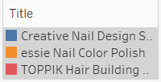
This graph is showing yearly sales of our 3 top-selling products. Another thing to note is that the number of products sold increased post-2010 gradually and declined again in 2018, this may be a reason as internet communication wasn't that vast worldwide before 2010 and after 2018 maybe beacuse of stiff competition our sales went down.
https://niitlearning.trai ning.com/educate/niit
-
digital/nd/index.html#
/program/150388
10

Slide 11
Sentiment Analysis
Sentiment Analysis is an approach that identifies the emotional tone behind any particular text or reviews
1
2
TEXT VECTORIZATION
TEXT-PREPROCESSING
3
CREATING THE MODELS
PROBLEMREMOVE ALL NON-LETTERS AND NON-SPACES EXCEPT FOR HYPHENS AND DIGITS
REMOVE ALL NUMBERS EXCEPT THOSE ATTACHED TO A WORD
REMOVE ALL HYPHENS EXCEPT BETWEEN TWO WORDS
REMOVE ALL URLS REMOVE MULTIPLE SPACES REMOVE STOP WORDS LEMMITIZATION
TF-IDF COUNTVECTORIZER USING N-GRAMS(1,2)
MULTINOMIAL NAIVE BAYES LOGISTIC REGRESSION WITH ONE VS REST CLASSIFIER DECISION TREE
RANDOM FOREST
4
CONCLUSION
Interpret the results and write our conclusion.
11

Slide 12
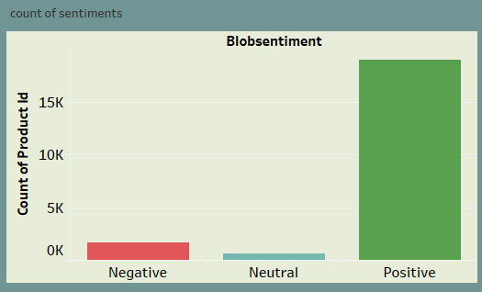
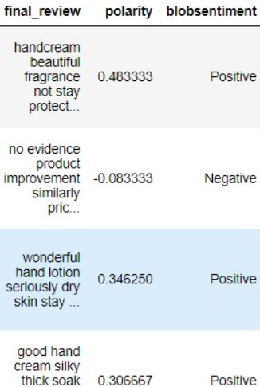

TEXT PREPROCESSING
We have used TextBlob library to find the sentiments of the reviews.
TextBlob is a python library for Natural Language Processing (NLP).
TextBlob returns the polarity and subjectivity of a sentence. Polarity lies between [ -1 , 1 ] , -1 defines a negative sentiment and 1 defines a positive sentiment.
After removing the bias in the data, this the proportion of different sentiments which we will be using to create the classifier model
Since or data is imbalanced
so we need to do text augmentation
We have used the Wordnet library to create some artificial reviews of the negative and neutral reviews,
which are under-represented
by using synonyms of those reviews.
12

Slide 13
COMPARISON OF DIFFERENT MODELS
MODEL WITH TF-IDF VECTORIZER | ACCURACY | PRECISION | RECALL | FI-SCORE
MULTINOMIAL NAIVE BAYES | 0.9038 | 0.8976 | 0.9038 | 0.8707
LOGISTIC REGRESSION (ONE V/S REST CLASSIFIER) | 0.9299 | 0.940 | 0.93 | 0.933
DECISION TREE CLASSIFIER | 0.7668 | 0.9006 | 0.77 | 0.8122
RANDOM FOREST CLASSIFIER | 0.8857 | 0.8602 | 0.886 | 0.853
MODEL WITH COUNT VECTORIZER N-GRAMS(1,2) | ACCURACY | RECALL | PRECISION | FI-SCORE
MULTINOMIAL NAIVE BAYES | 0.915 | 0.916 | 0.903 | 0.9005
LOGISTIC REGRESSION (ONE V/S REST CLASSIFIER) | 0.927 | 0.928 | 0.942 | 0.912
DECISION TREE CLASSIFIER | 0.761 | 0.762 | 0.902 | 0.808
RANDOM FOREST CLASSIFIER | 0.893 | 0.895 | 0.846 | 0.847
AS WE CAN SEE LOGISTIC REGRESSION WITH ONE VS REST CLASSIFIER OFFERS BEST ACCURACY AND F-1 SCORES. SO WE WILL BE USING THIS MODEL FOR CLASIFYING THE REVIEWS
13

Slide 14
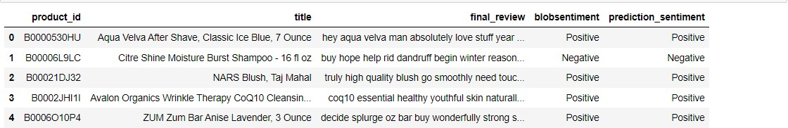
Prediction on unseen data
Above table shows the output of Logistic Regression model on unknown review text Thus we are able to achieve the very first objective of making a well automated review
system wherein according to sentiments of a particular review one can decide on whether or not to buy a particular product.
14

Slide 15
The Stages of Product Segmentation
REASON
TO CLUSTER THE PRODUCTS FOR RECOMMENDING BEST
PRODUCTS TO OUR CUSTOMERS AND IMPROVING THE BAD PRODUCTS FOR TIME AHEAD.
1
OBJECTIVE
PRODUCT SEGMENTATION
2
3
APPROACH
4
MODELS USED
The clustering approaches we have performed here are of 2 types:
K-means Algorithm
Agglomerative Clustering
5
RESULT
We have categorized products into :
Best products
Good products
Average products
Clustering has been performed on the basis of Product ratings and Sentiments
15

Slide 16
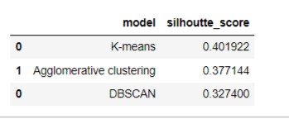
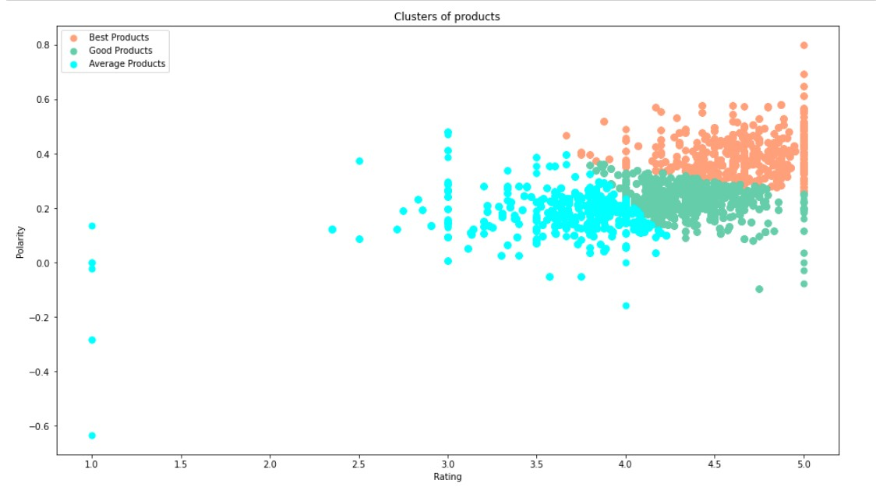
COMPARISON OF OUR MODELS
We have used the Silhouette score as the performance metric for comparing the model's effectiveness.
As silhoutte score of K-Means algorithm is better we will use this model for our product segmentation
This graph is showing the categorization of products into :
Best products - Having high polarity and high
rating
Good products - Having high polarity but a
comparatively lower rating
Average products - Having low polarity and
low rating
16

Slide 17
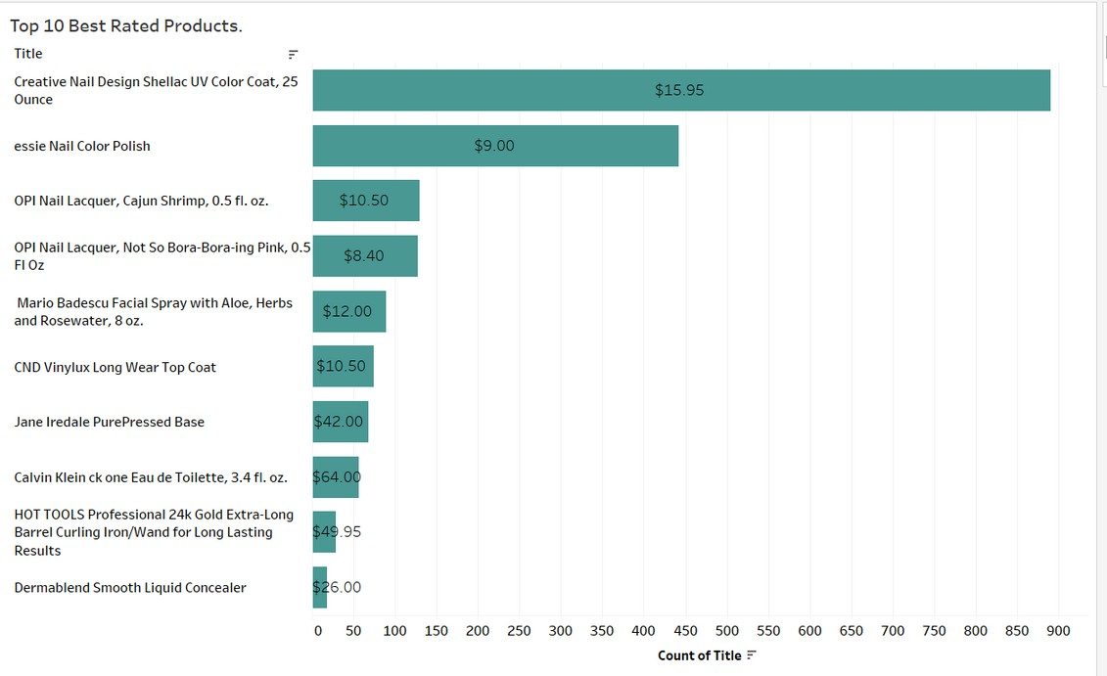
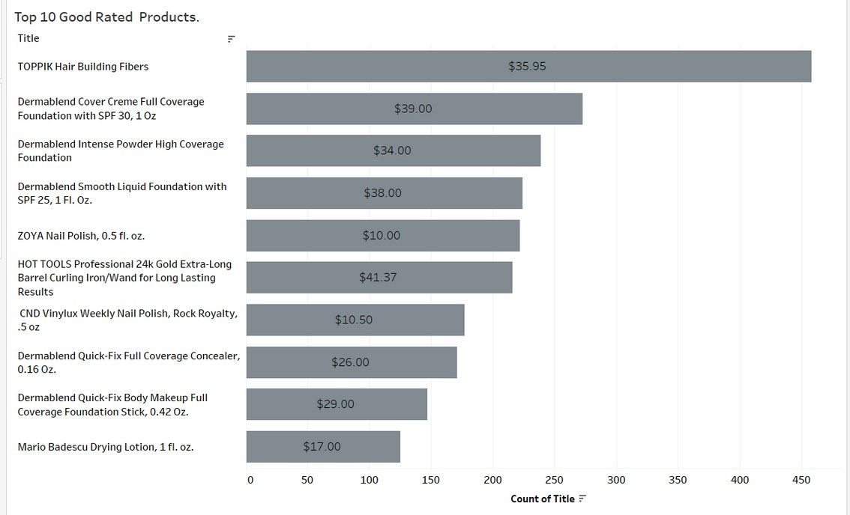
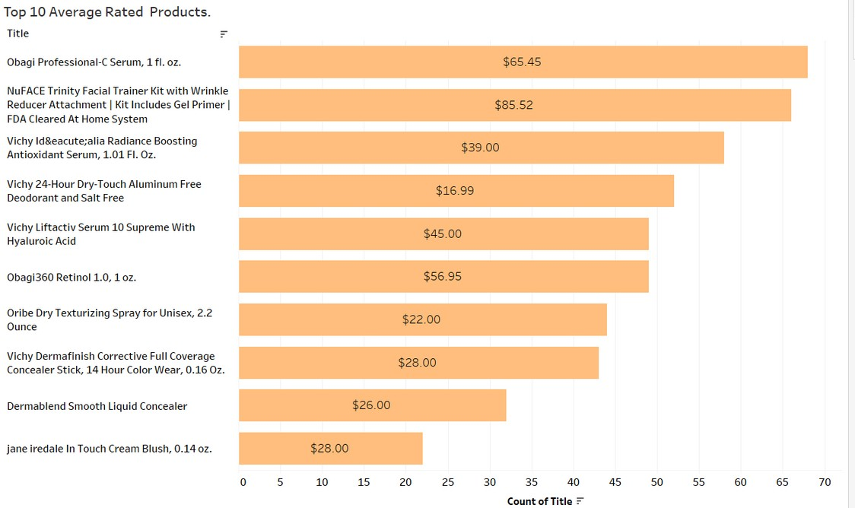
17

Slide 18
The Stages of Customer Segmentation
OBJECTIVE
REASON
APPROACH
MODELS USED
RESULT
1.To cluster the customers as Highly Satisfied, Satisfied and dissatisfied.
Identified 3 clusters of customers:
Clustering has been performed on the basis of Product ratings and Sentiments
K-means Algorithm
Agglomerative Clustering
CUSTOMER SEGMENTATION
2. To adopt measures for Dissatisfied customers like promotion campaigns, discounts so that they do not churn out
1. Very Satisfied
Customers Satisfied Customers
3. Dis-Satisfied
Customers
2.
18

Slide 19
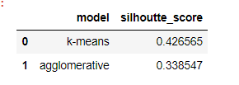
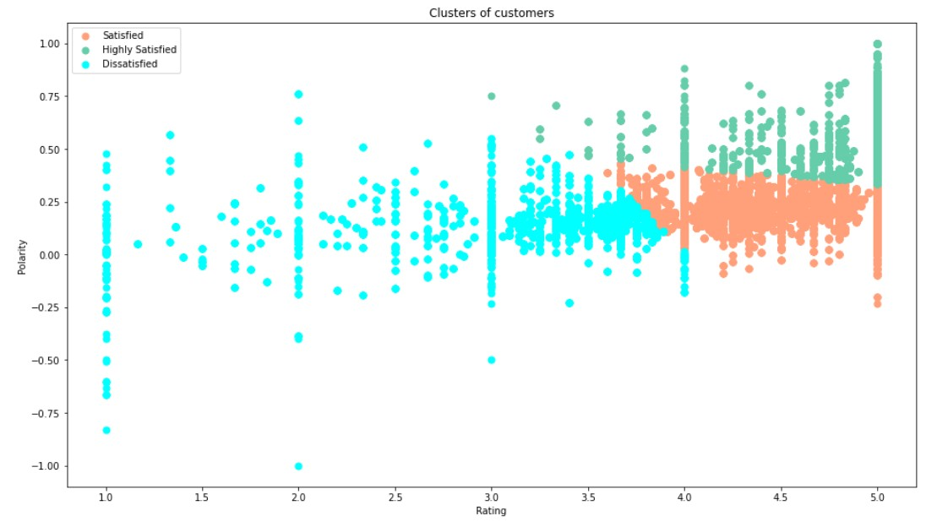
COMPARISON OF MODELS
We have used Silhoutte score as the performance metric for comparing the model's effectiveness.
As silhoutte score of K-Means algorithm is better we will use this model for
our CUSTOMER segmentation
This graph is showing the categorization of customers into :
Highly Satisfied - Having high polarity and high rating
Satisfied - Having a high rating but the comparatively lower polarity
Dissatisfied - Having low polarity and low rating
19

Slide 20
CUSTOMER SEGMENTS
20

Slide 21
SENTIMENT BASED PRODUCT DEMAND FORECASTING
The ability of forecasting a future event to take place is one of the key role of a business , it make scientific predictions based on historical time stamped data,
so that the company can make informed business decisions.
3
1
2
STATISTICAL DECOMPOSITION
RESAMPLING OF DATA
STATIONARITY TEST
CHECKING FOR THE TREND IN OUR DATA.
CHECK SEASONALITY IN OUR DATA. CHECK RESIDUALS IN OUR DATA.
RESAMPLING IS FOR FREQUENCY CONVERSION WHICH ENSURES THAT THE DATA IS DISTRIBUTED WITH A CONSISTENT FREQUENCY.
WE RESAMPLED OUR DATA ON MONTHLY WISE FOR THE COUNT OF PRODUCT ID"S AS PER THEIR SENTIMENT.
BY THIS WE CAN SIMPLY FIND THE COUNT OF SOLD PRODUCTS AS PER THEIR SENTIMENTS .
ADF TEST.
USED LAG DIFFERENCING TECHNIQUE TO MAKE OUR DATA STATIONARY
FORECASTING
Forecasted the demand of the products by choosing our best model.
4
MODELS USED
ARIMA MODEL SARIMA MODEL
5
21

Slide 22
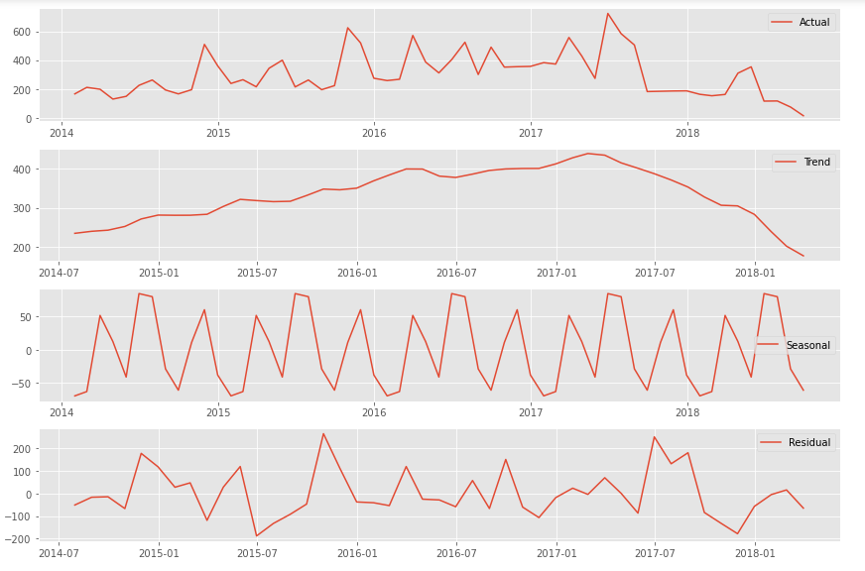
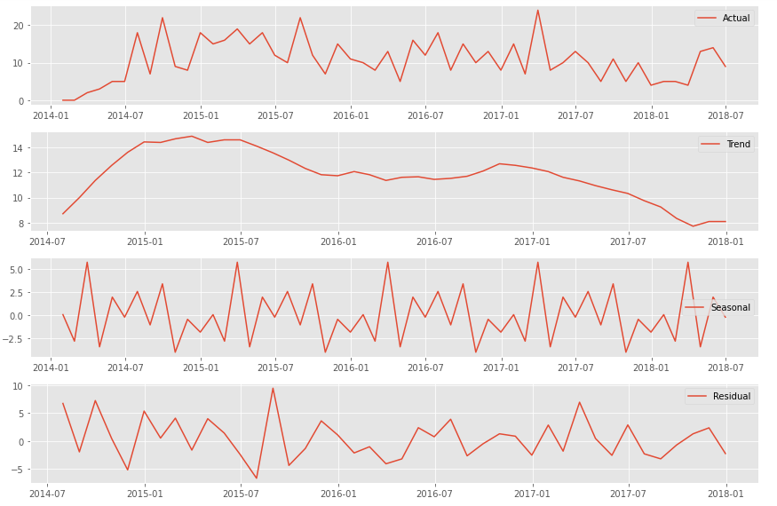
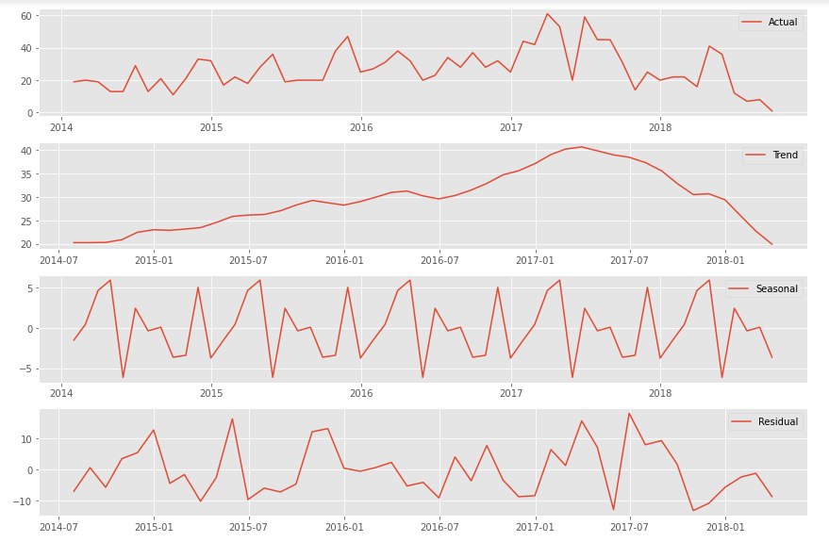
DECOMPOSIT ION GRAPHS F O R
POSIT IVE SENT IMENT S :
DECOMPOSIT ION GRAPHS F O R NEUTRAL SENT IMENT S :
DECOMPOSIT ION GRAPHS F O R NEGAT IVE SENT IMENT S :
Trend: For the positive sentiments we can see that count of product id’s increased till January 2017 and after it starts decreasing.
Seasonality : For the positive sentiments as per the count of product id’s we can observes a seasonality after gap of a year.
Residuals : We can see that the residuals are increasing as or decreasing as per the trend.
Trend: For the neutral sentiments we can see that count of product id’s increased till July 2015 and after it starts decreasing.
Seasonality : For the Neutral sentiments as per the count of product id’s we can observes a seasonality after gap of a year.
Residuals : We can see that the residuals are increasing as or decreasing as per the trend.
Trend: For the negative sentiments we can see that count of product id’s increased till January 2017 and after it starts decreasing.
Seasonality : For the negative sentiments as per the count of product id’s we can observes a seasonality after gap of a year.
Residuals : We can see that the residuals are increasing as or decreasing as per the trend.
22

Slide 23
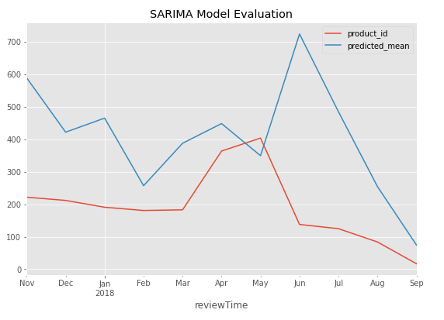
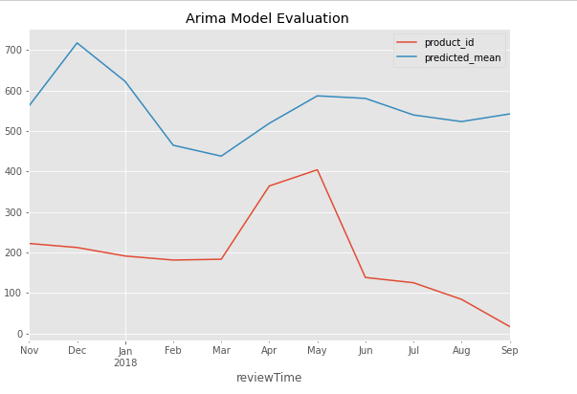
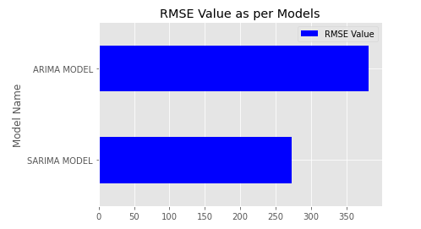
COMPARISON OF MODELS FOR CHOOSING THE BEST ONE FOR FORECASTING :
From these graphs we can clearly see that SARIMAX Model giving the low error and the predicting values are more closer to the actual in comparison of ARIMA Model. And as we know that lower the RMSE value the better our model performs.
So, we chose SARIMAX Model for the final forecasting by choosing the best p,d,q parameters for the low AIC score.
23

Slide 24
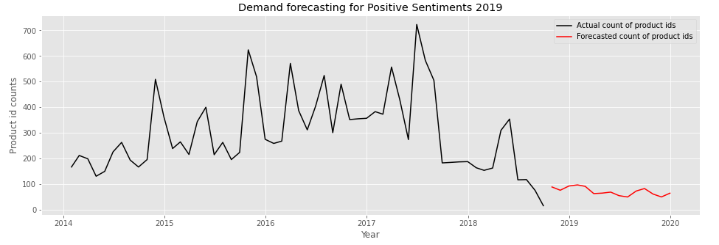
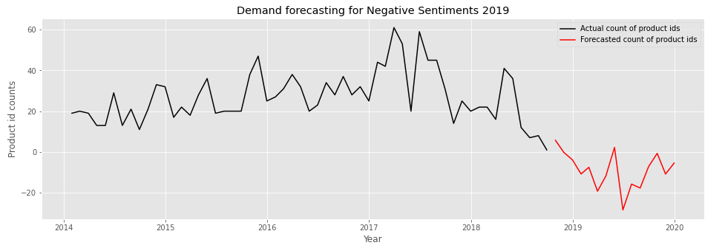
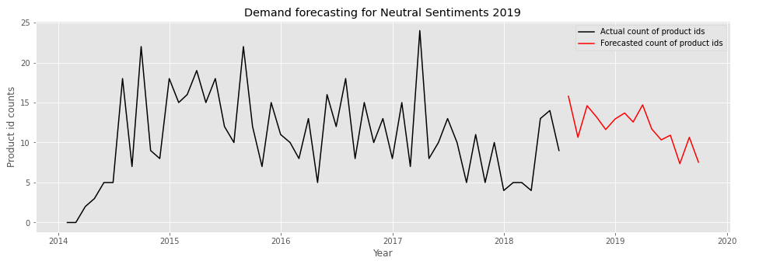
FORECASTING FOR COUNT OF PRODUCTS PER SENTIMENTS :
POSITIVE SENTIMENTS
From this forecasted graph we can see that for the upcoming year 2019 the count of the products with positive sentiments will decreased,
So which means that the costumers will not be much satisfied with the service.
From this forecasted graph we can see that for the upcoming year 2019 the count of the products with negative sentiments will decreased in high rate,
which means that the costumers will not be satisfied with the service, so company needs to work on the quality of the products.
NEGATIVE SENTIMENTS
From this forecasted graph we can see that for the upcoming year 2019 the count of the products with neutral sentiments will decreased,
So which means that the costumers
who were giving neutral reviews there is a decline in shopping rate for them.
NEUTRAL SENTIMENTS
24

Slide 25
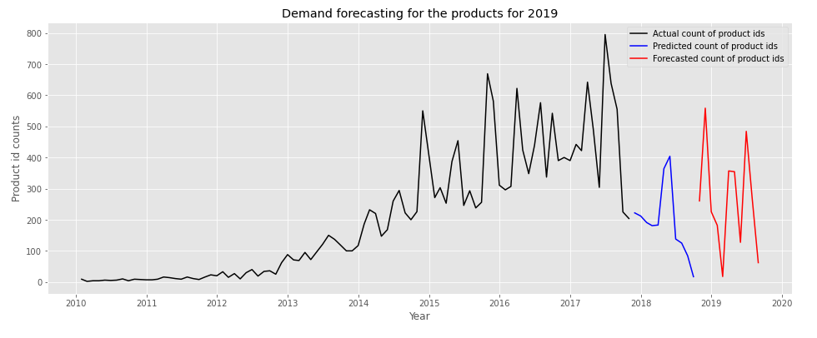
FORECASTING THE OVERALL DEMAND OF PRODUCTS FOR 2019 :
OBSERVATION:
Here when we check for the overall count of product id’s for all the sentiments ; we found that for the upcoming year 2019 the total count of the product id’s will be decreasing which means that the sales and the demand of the products will decreased. So, as we took our hypothesis that as the positive ,neutral sentiments decreasing for the upcoming year the demand will be decreasing got accepted. So the company needs to focus on the product quality as well as to the costumers who are likely to be churned out.
25

Slide 26
CONCLUSIONS
It is seen that among Luxury Beauty products the most popular products among customers are ELEMIS DAILY MOSITURE BOOST, ORIBE HAIR SHAMPOO, CREATIVE NAIL DESIGN SHELLAC and SKINMEDICA CREAM.
From our EDA we can see there is a decreament in the purchase rate of our premium customers BB, Leanne and Quickbeam after 2017.
Analysing our product clustering based on sentiments we observe that there is a significant difference in the sales of average rated product clusters as compared to best and good product clusters.
Analysing our customer clustering based on sentiments we observe that there is a significant difference in the Dissatisfied and Satisfied customer clusters as compared to Highly satisfied customers clusters.
From our time series forecasting we observe that the future sales and demand for products will fall as the customers will not be satisfied with the service.
As the positive and neutral reviews are decreasing so company needs to relaunch the least rated products after working on their quality and decrease some price also and recommend our best products to the costumers.
Company needs to provide some more festive, seasonal sales or discount offers to the costumers to attract them.
26

Slide 27


